Slide 1
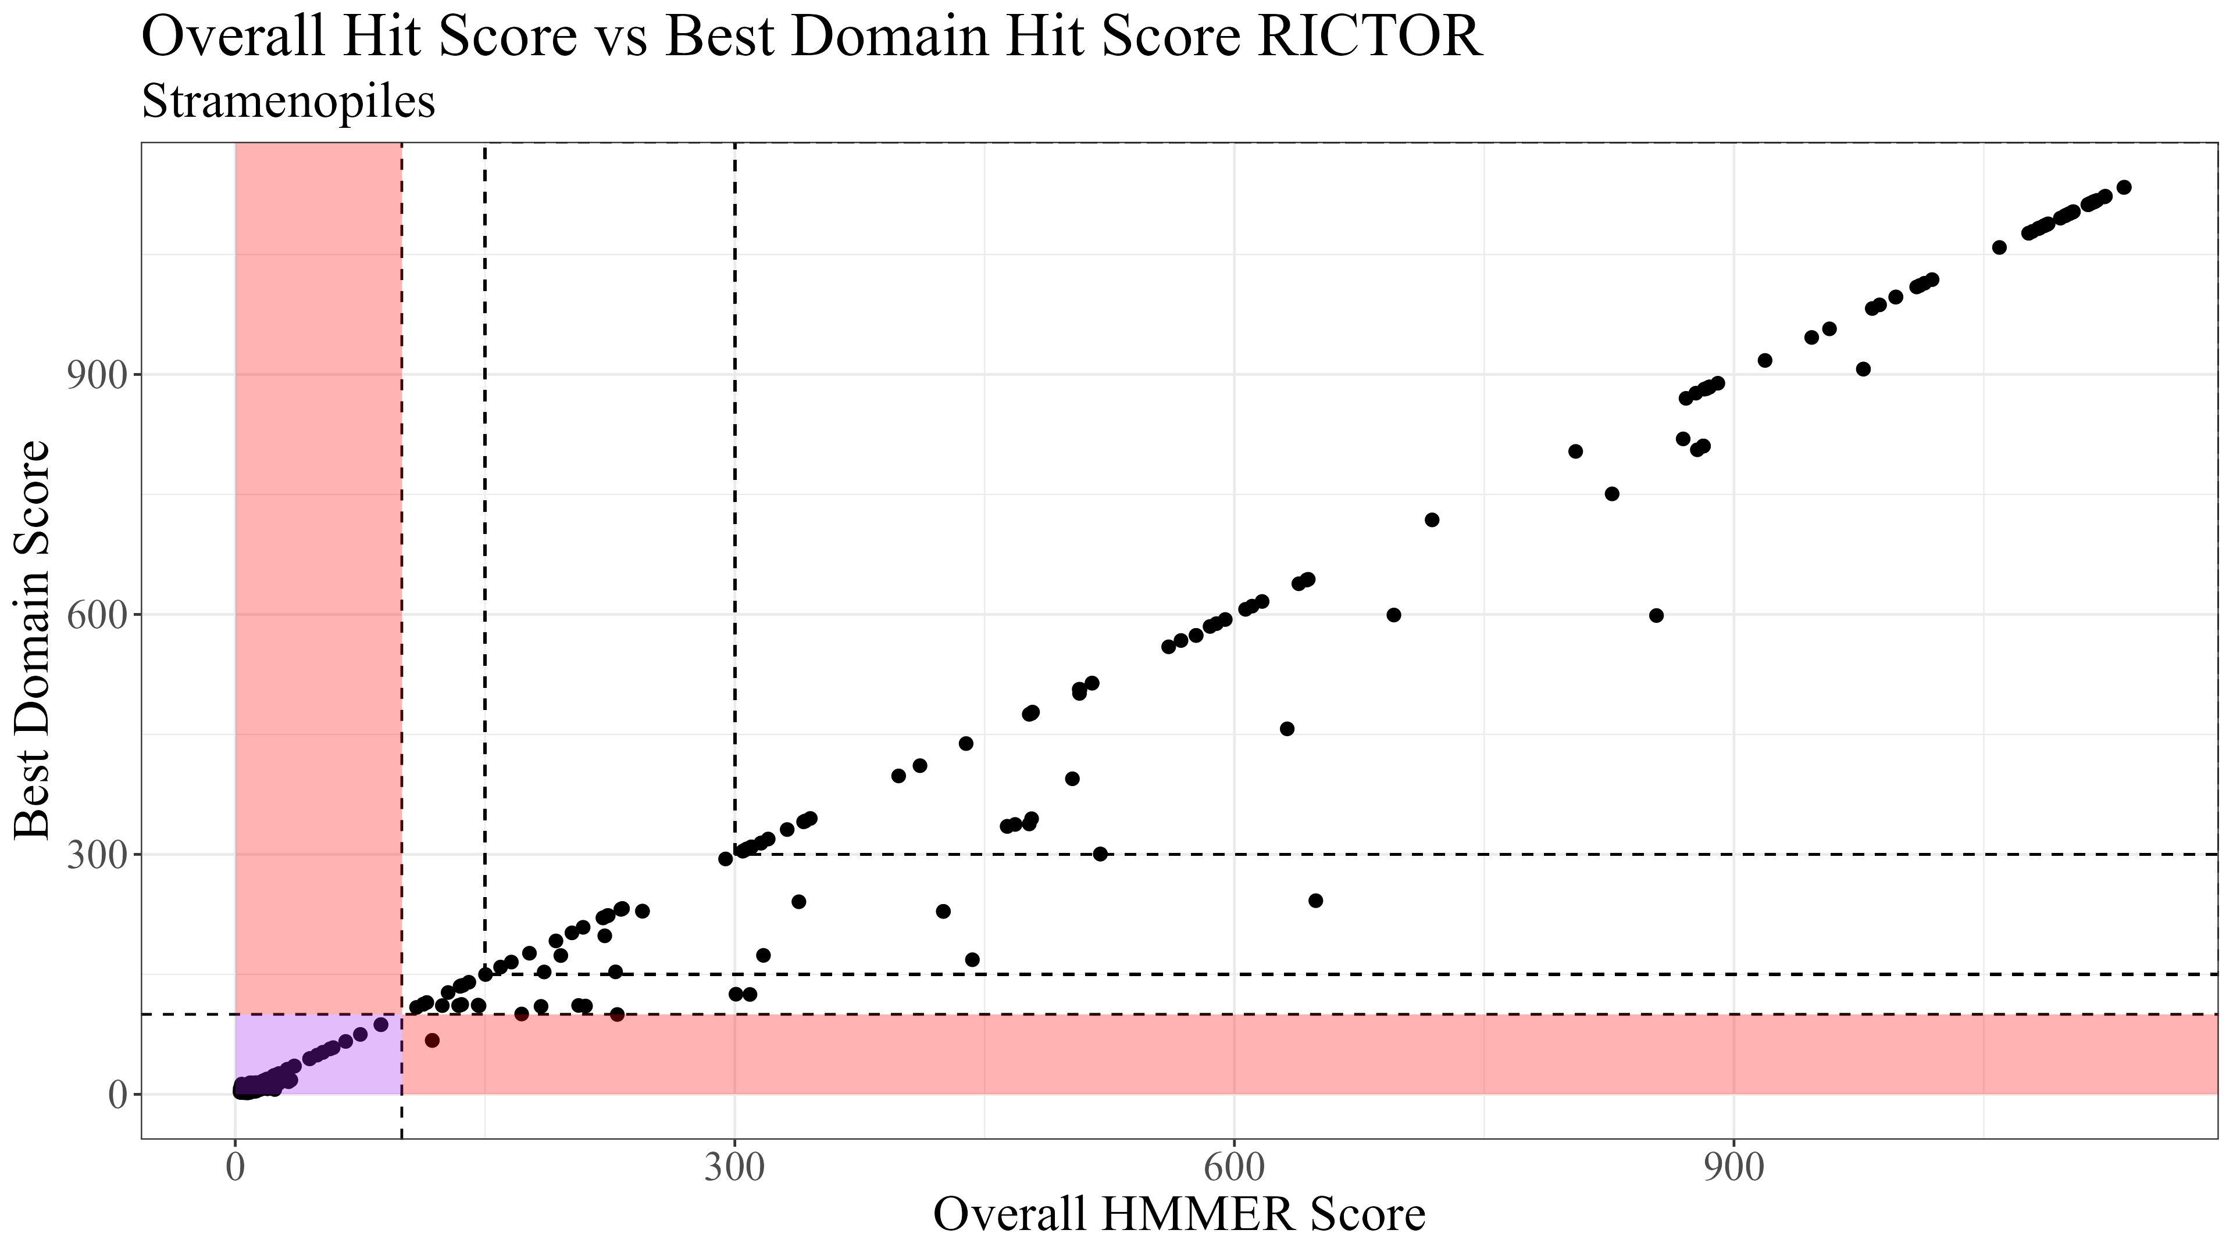
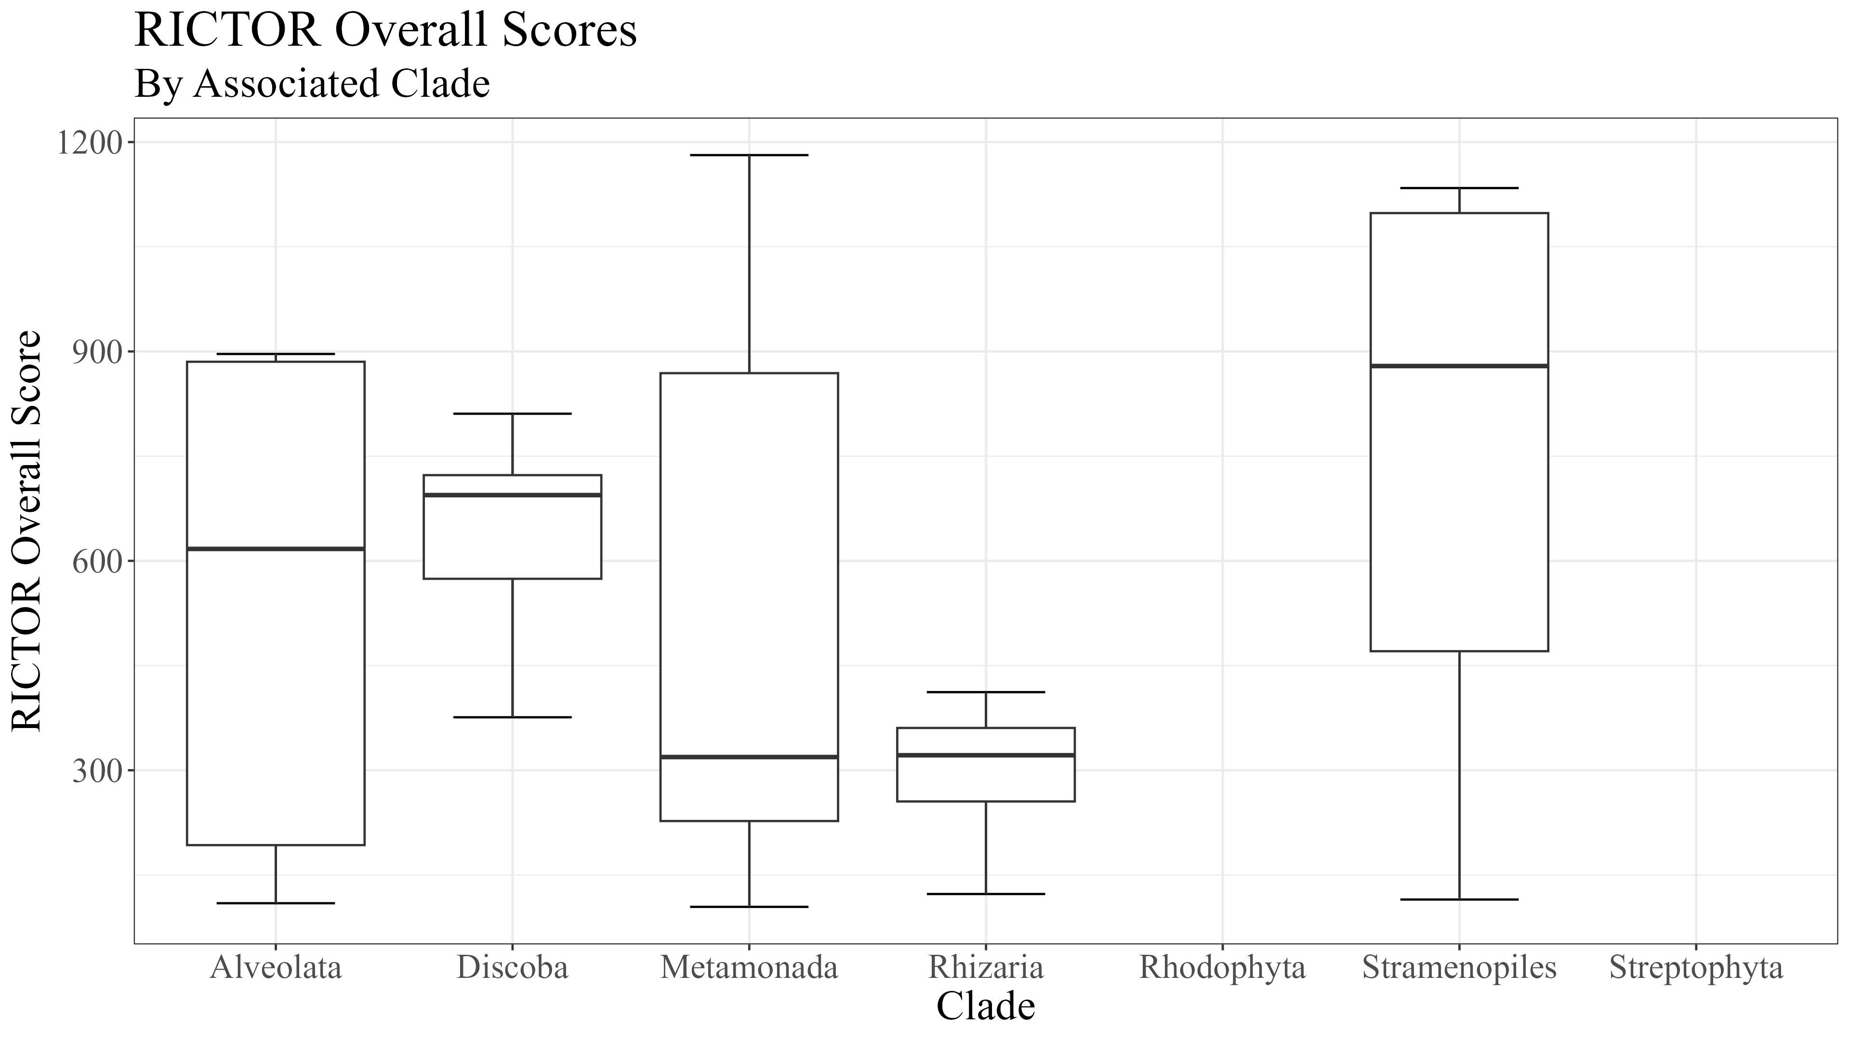
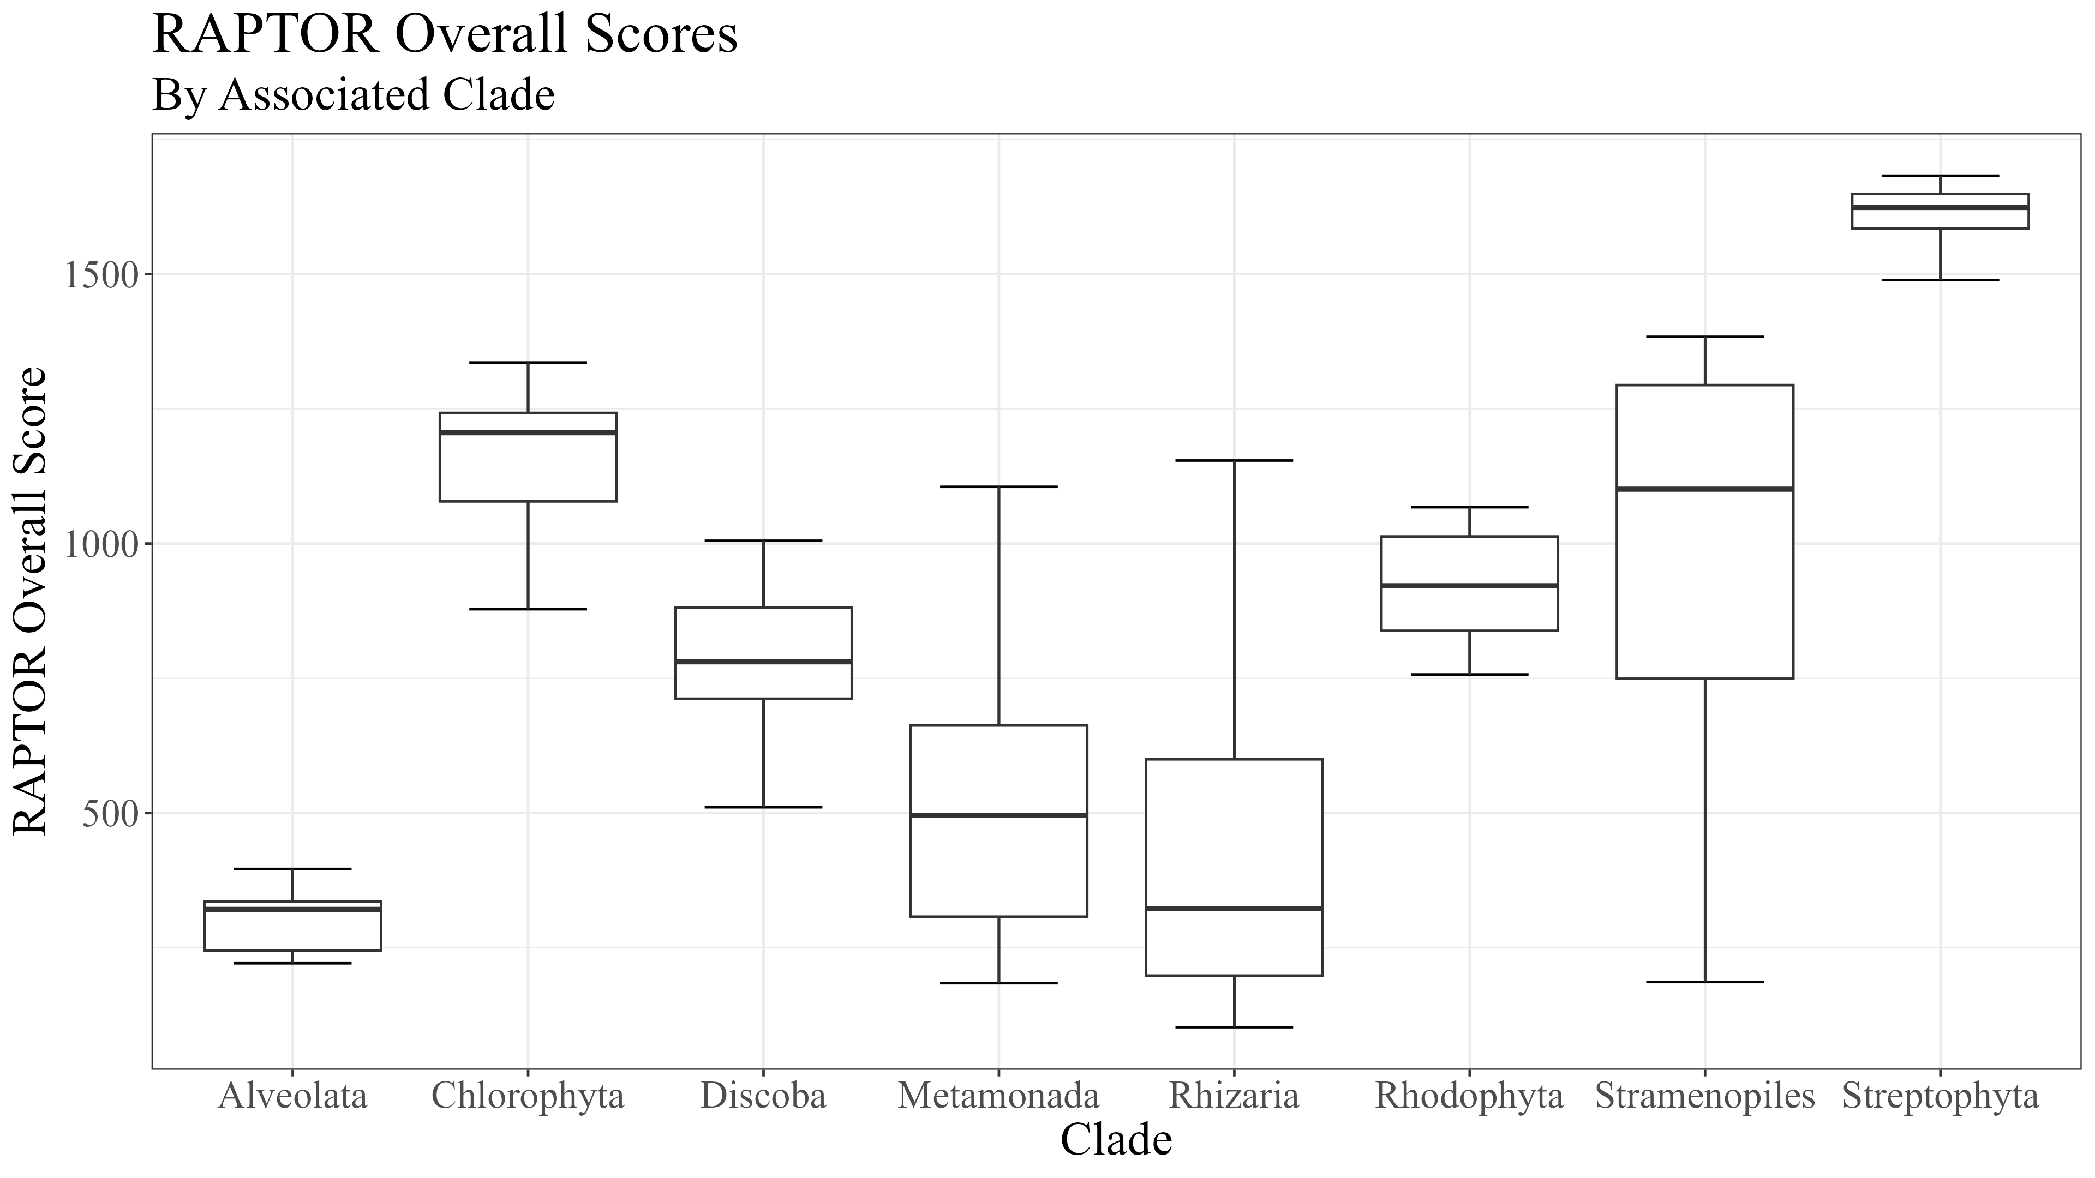
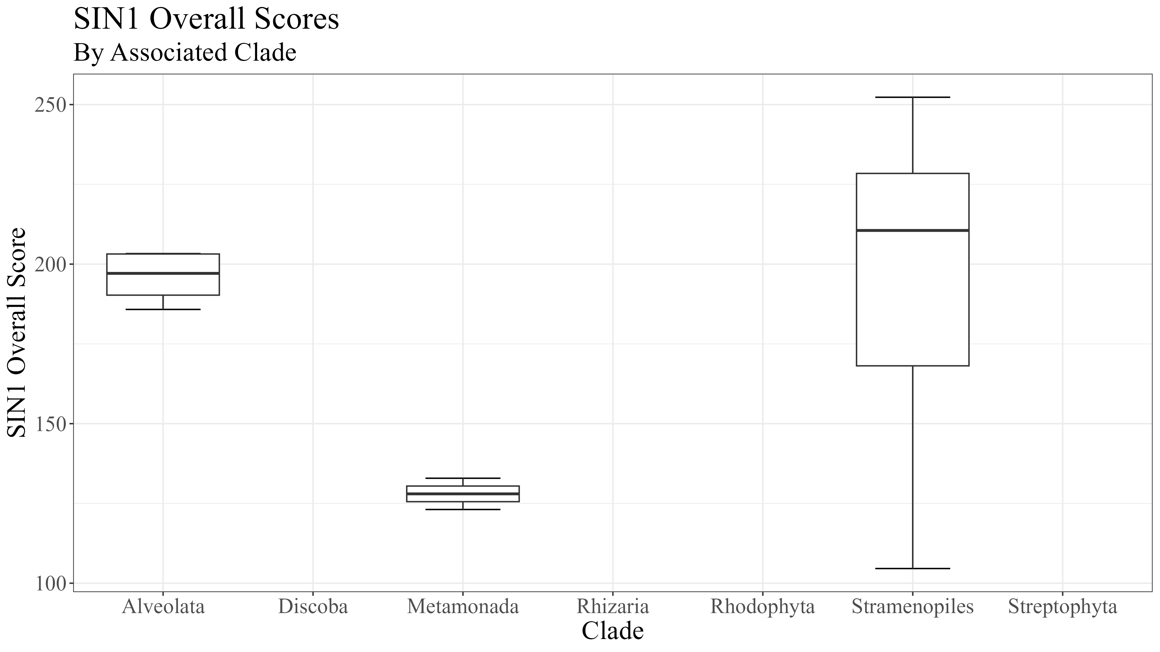
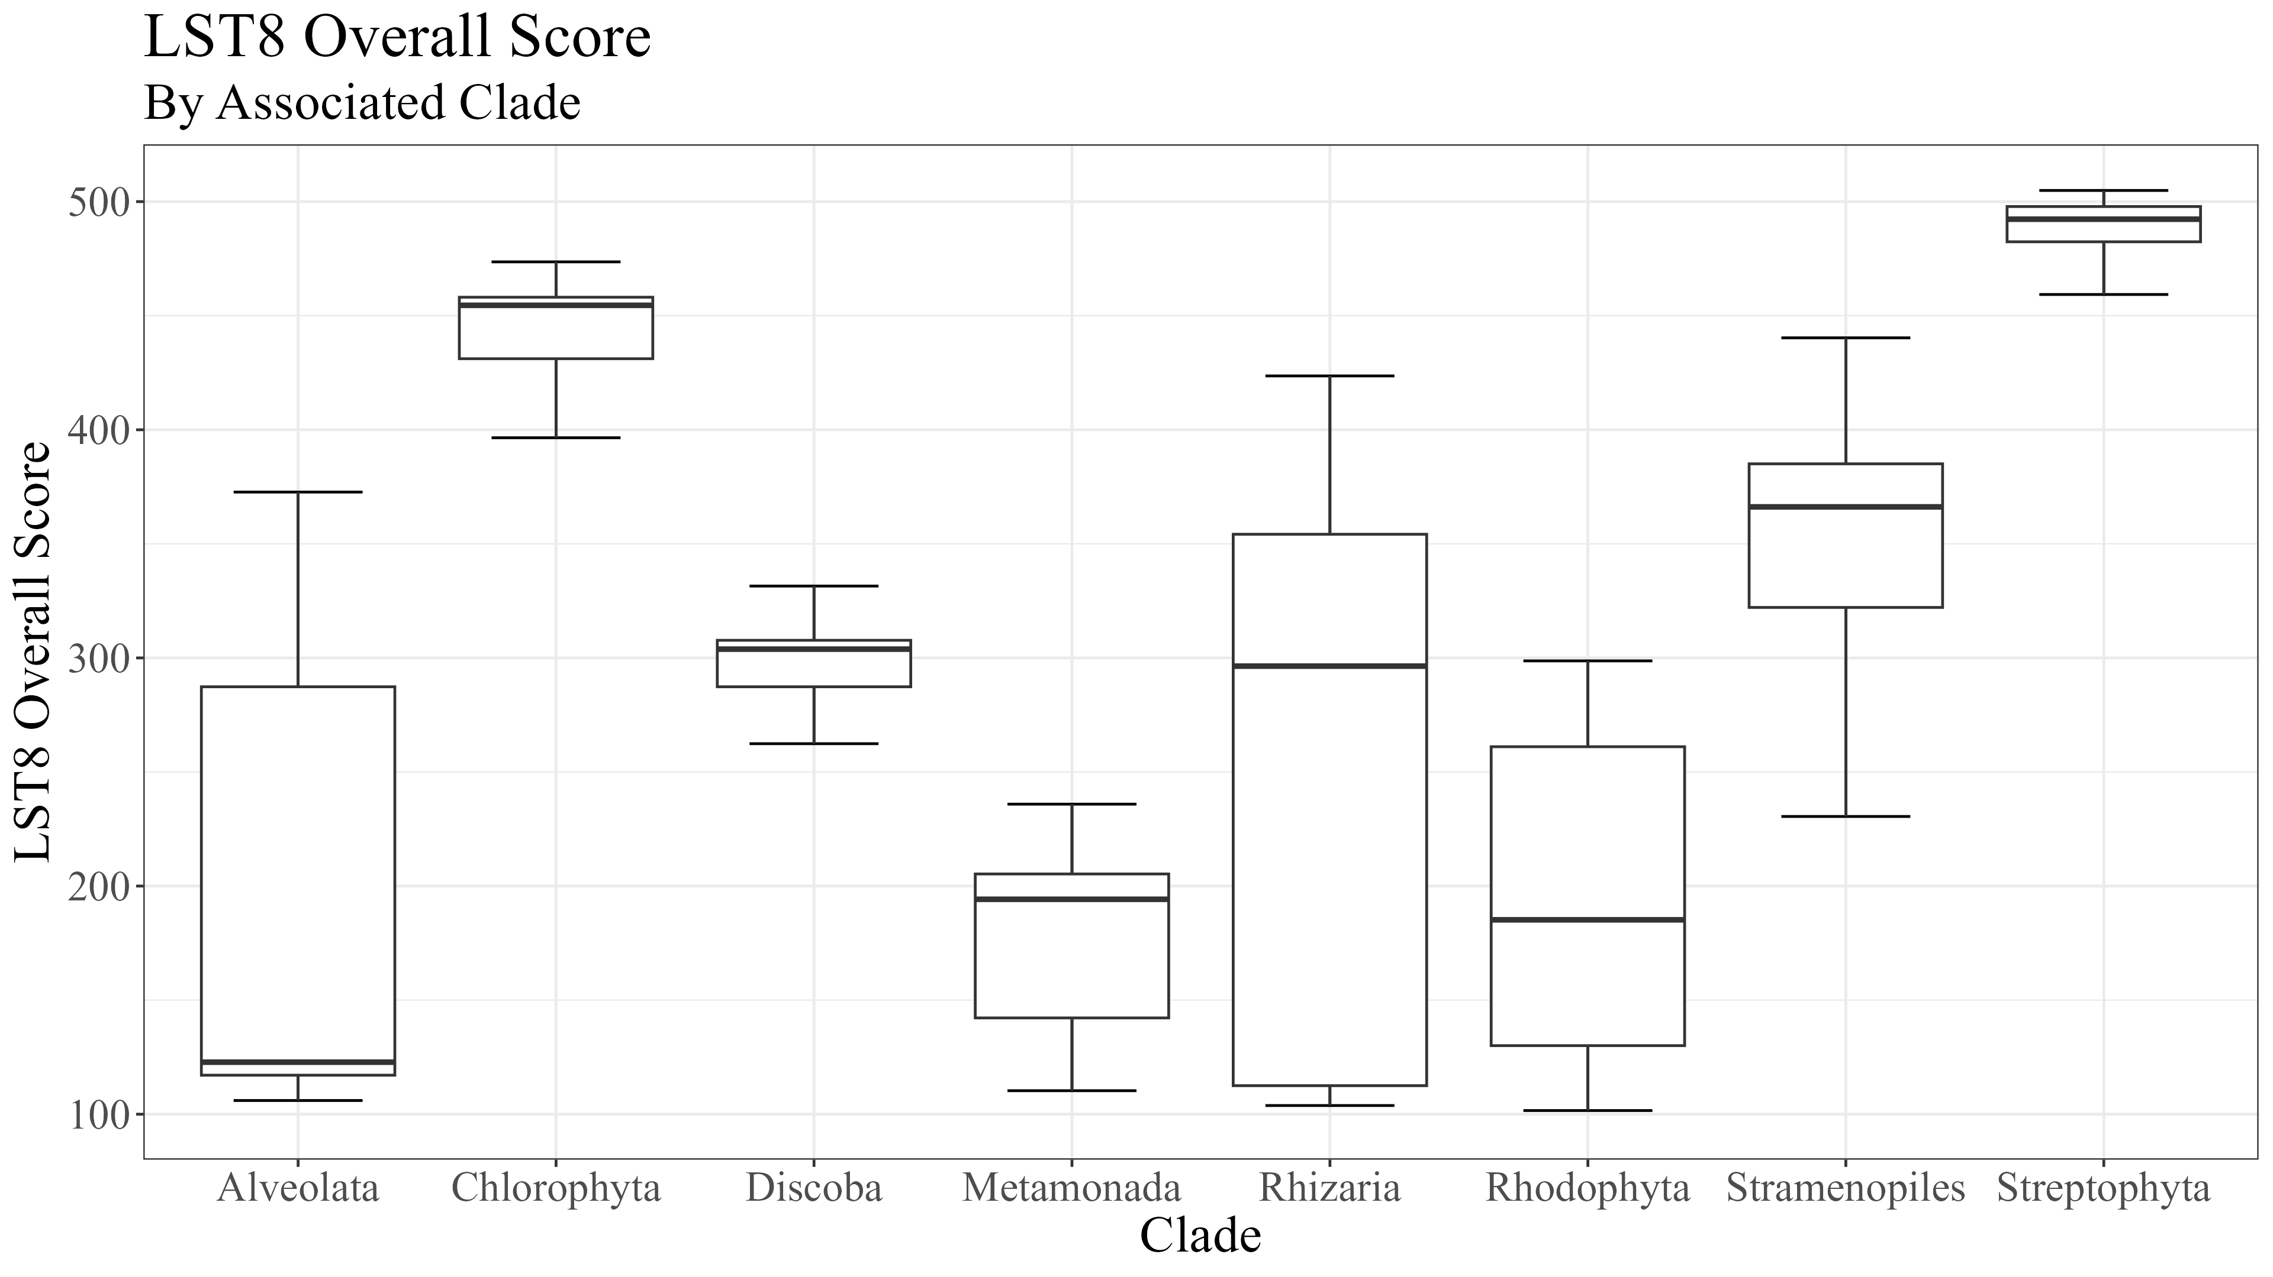
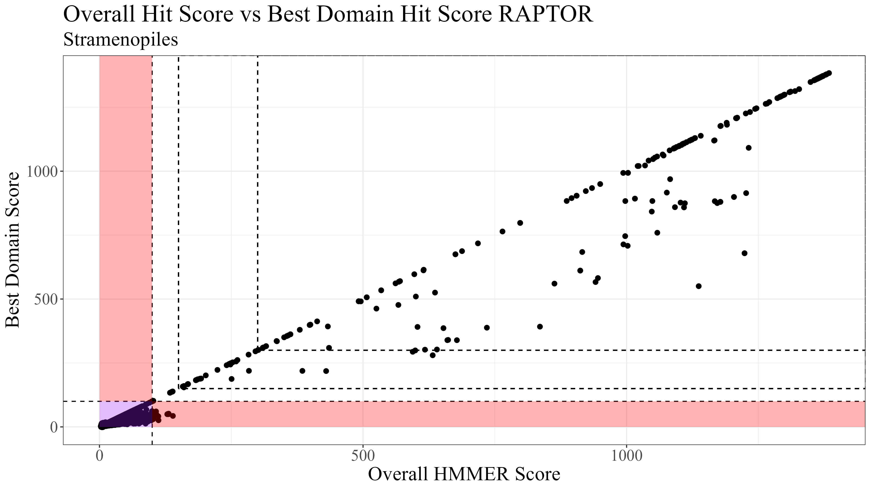
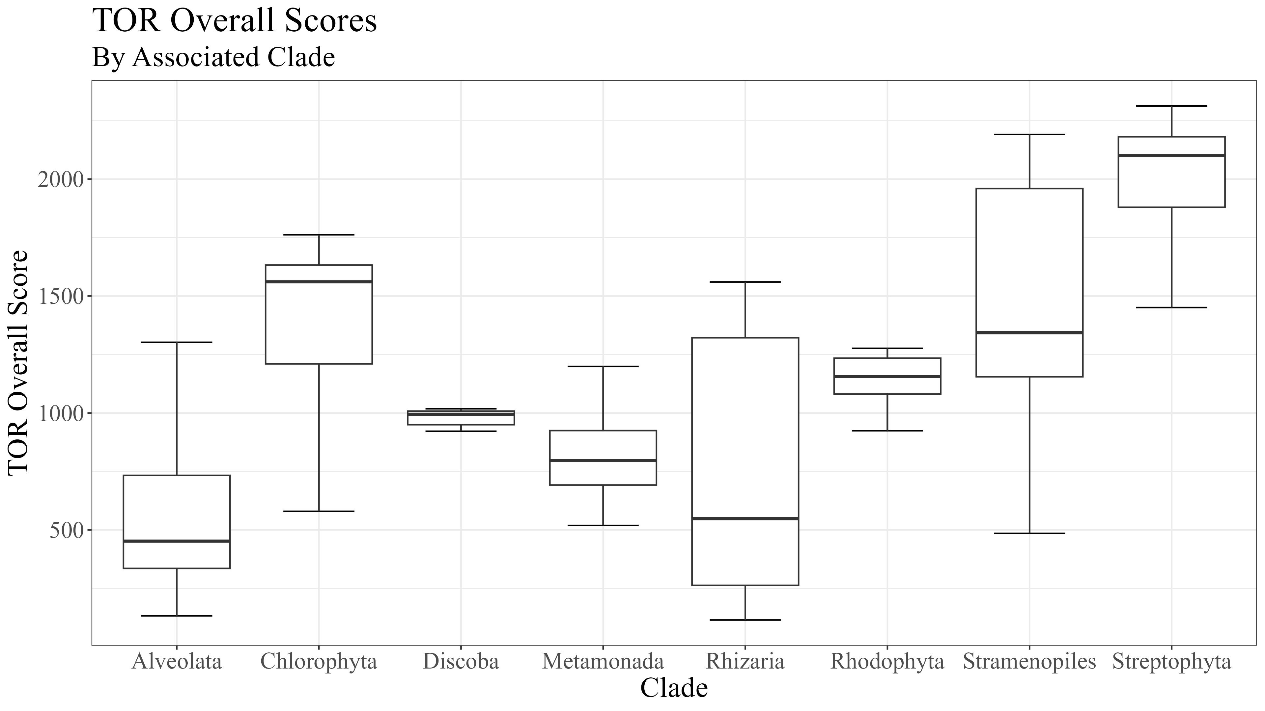
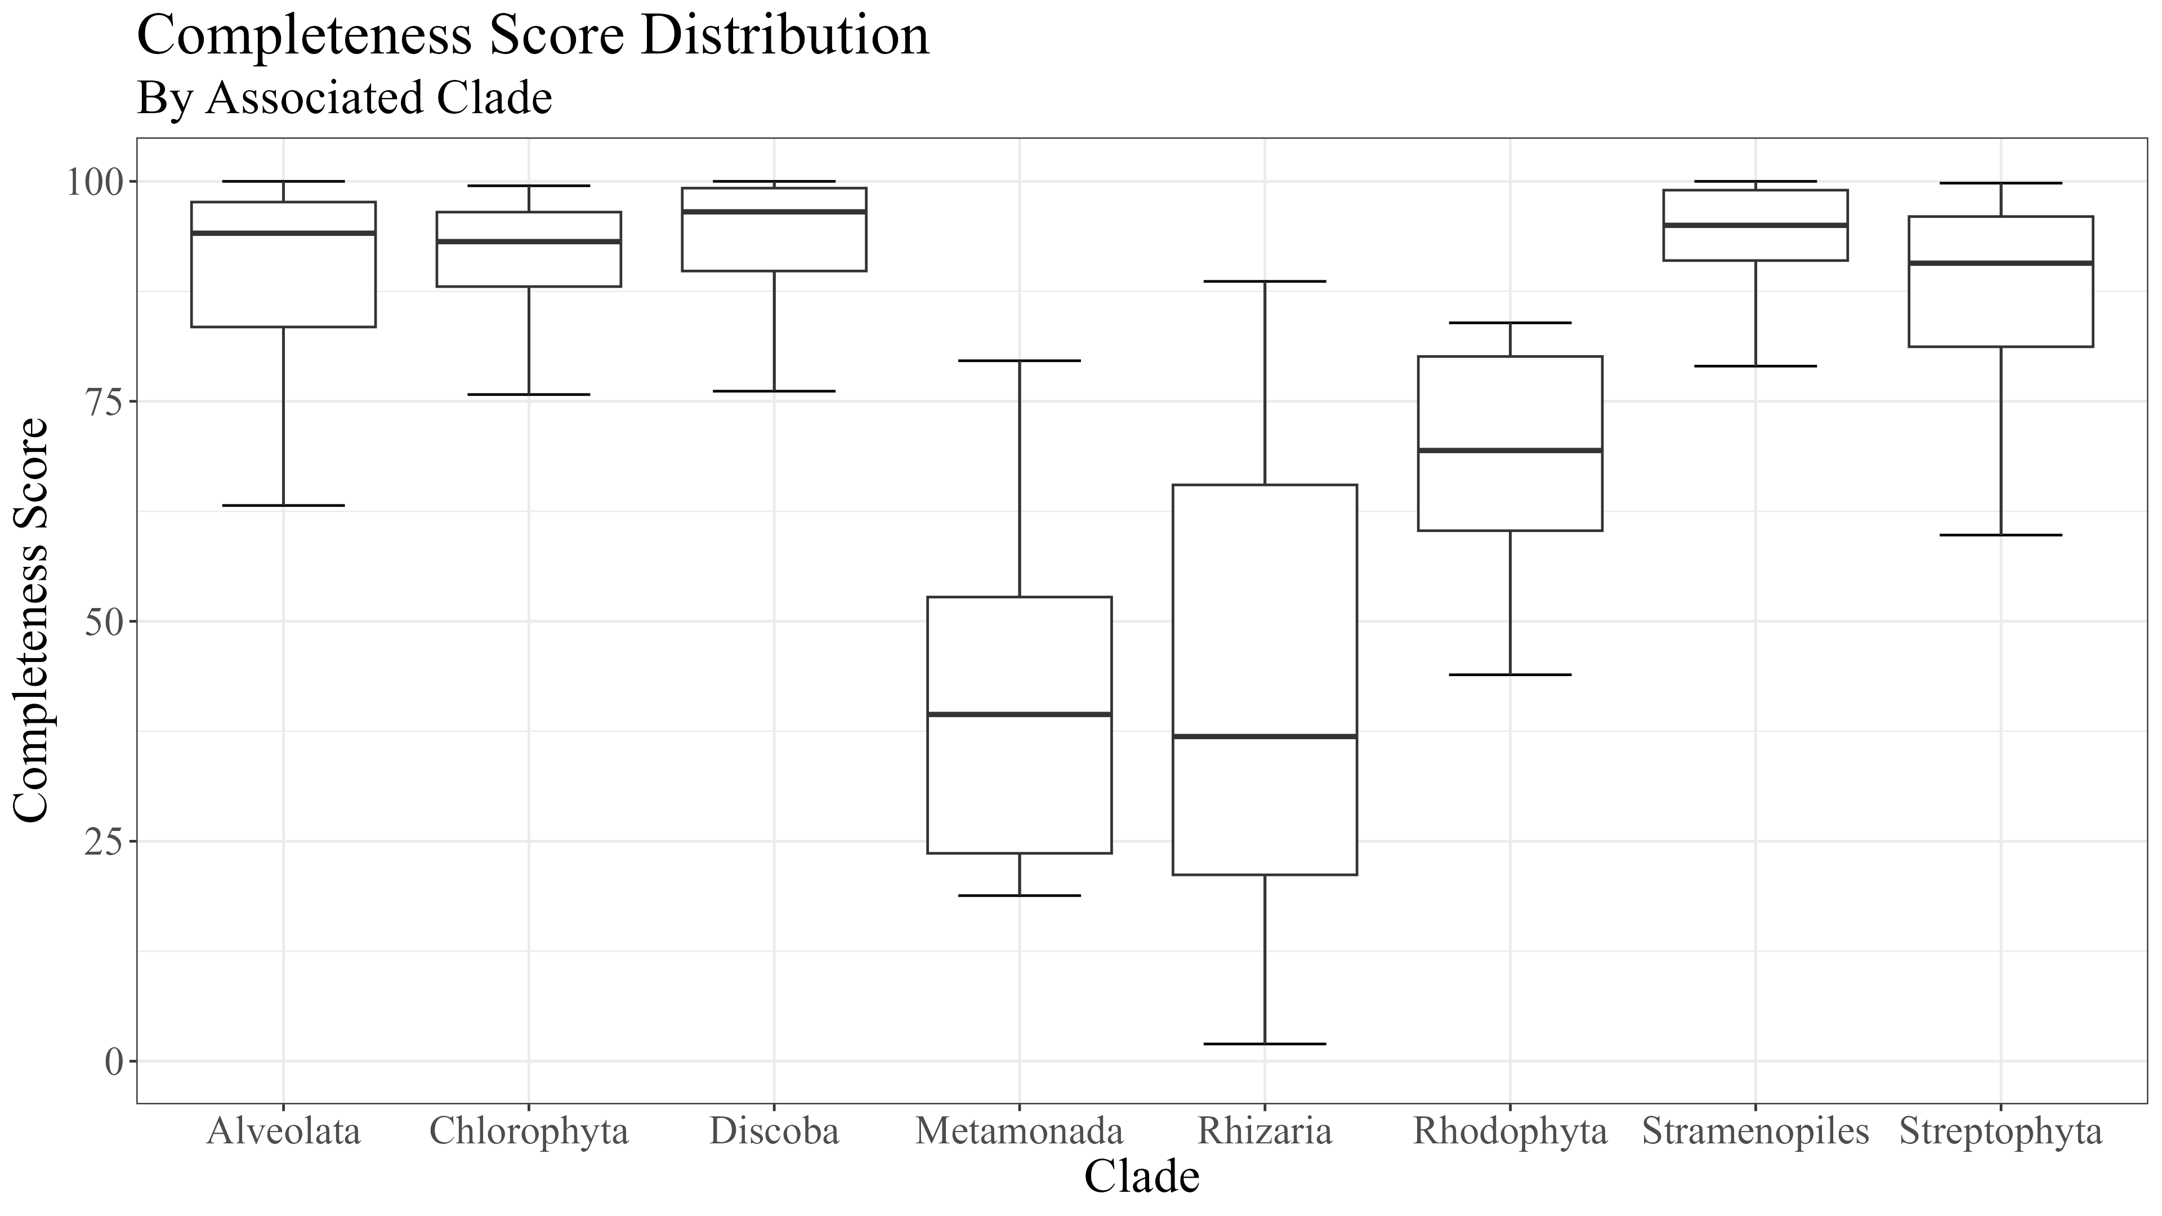
Supplemental 7
(A)
(B)
Notes:
Supplemental 1 (Need to Include HMMER Results here)

Slide 2
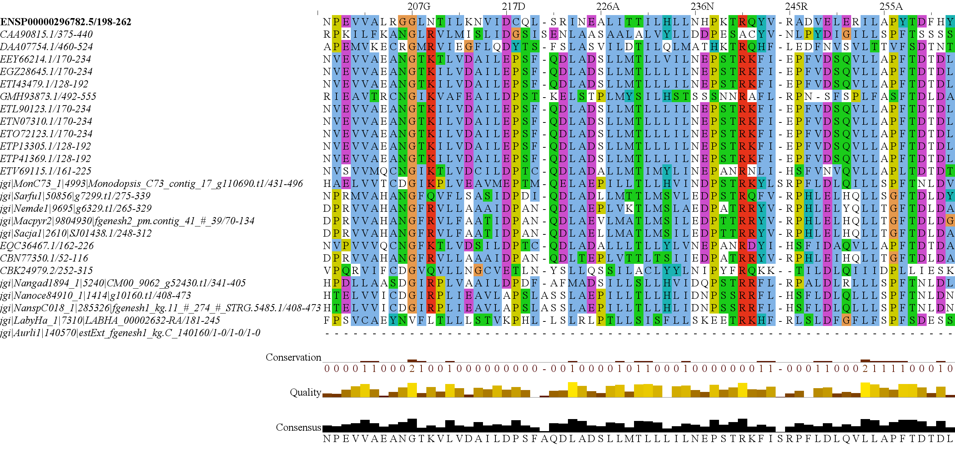
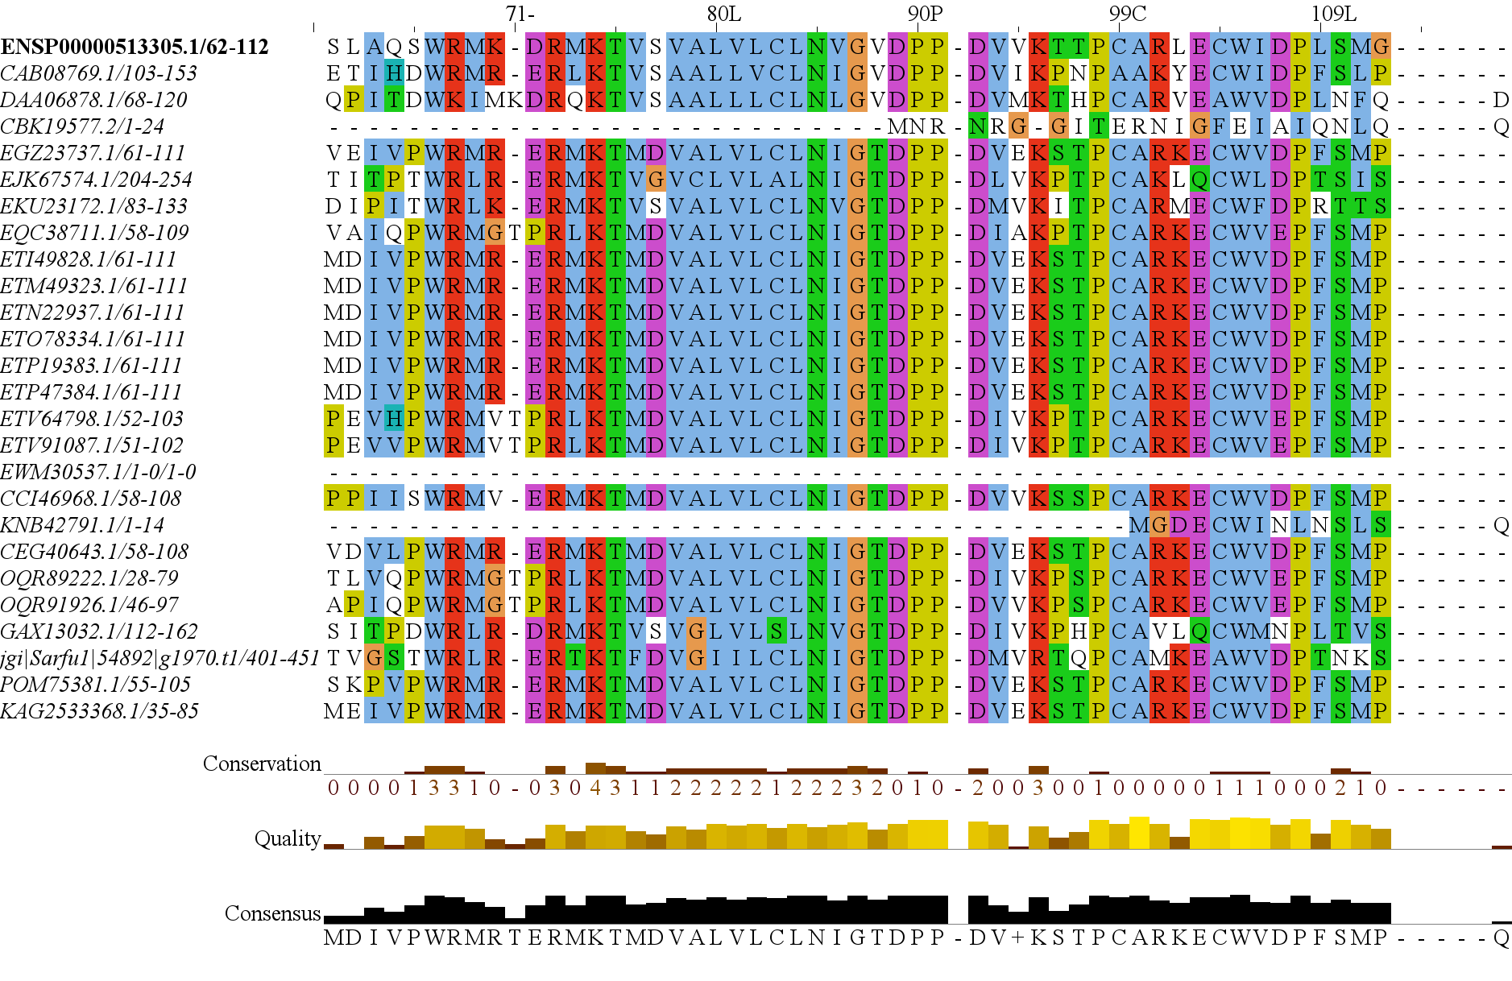
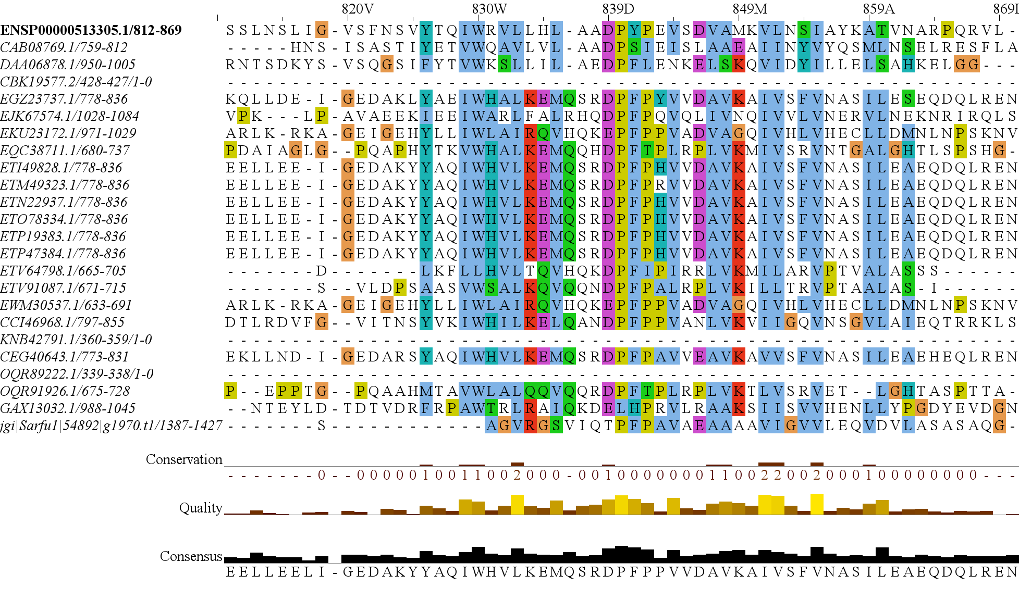
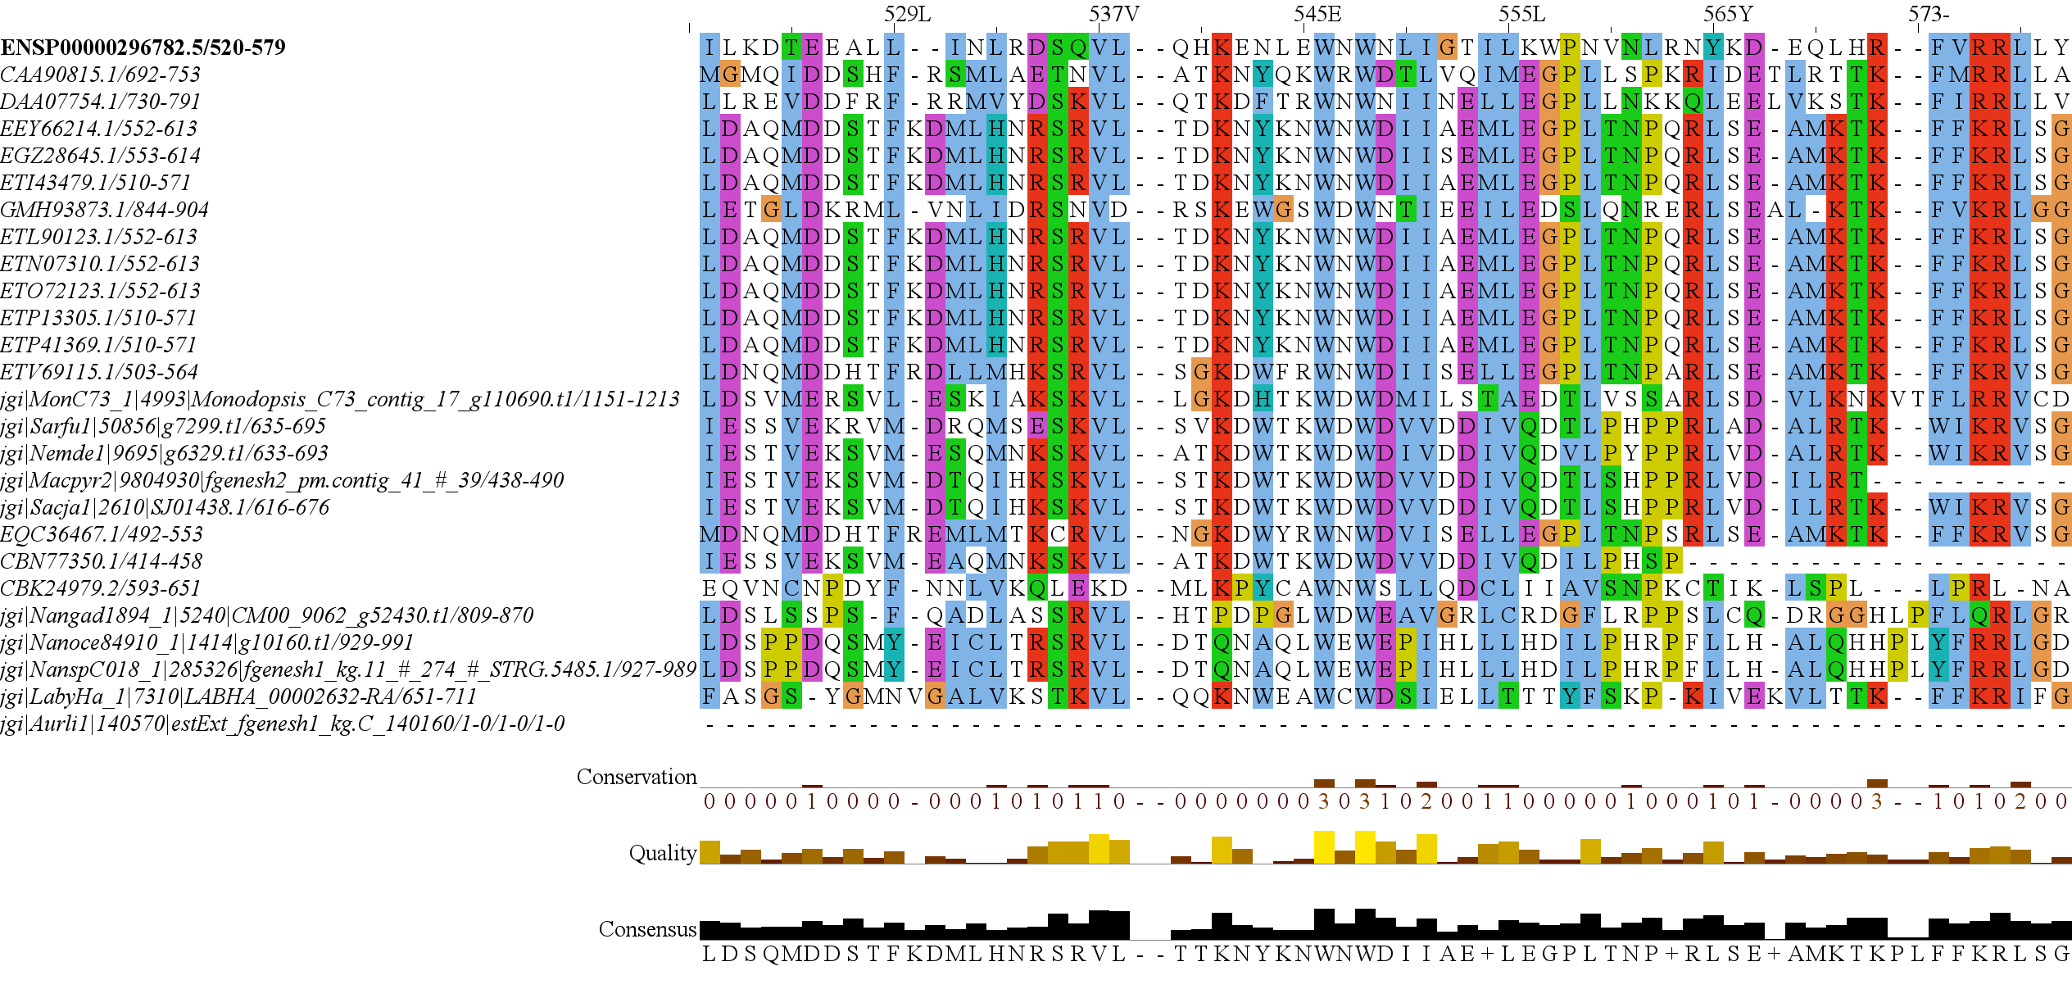
Supplemental 2
RICTOR
(A)
RAPTOR
(B)
N
N
RICTORN
RAPTORN
Reference
Reference
High
RICTORM
ARM
High
Medium
RasGEF
HEAT
Low
Medium
Dom5
ARM
Reference
Reference
RICTOR
Phosphor
WD-40
High
High
Medium
Medium
Low
C
C
Notes:
Supplemental 2 (MSA for RICTOR and RAPTOR)

Slide 3
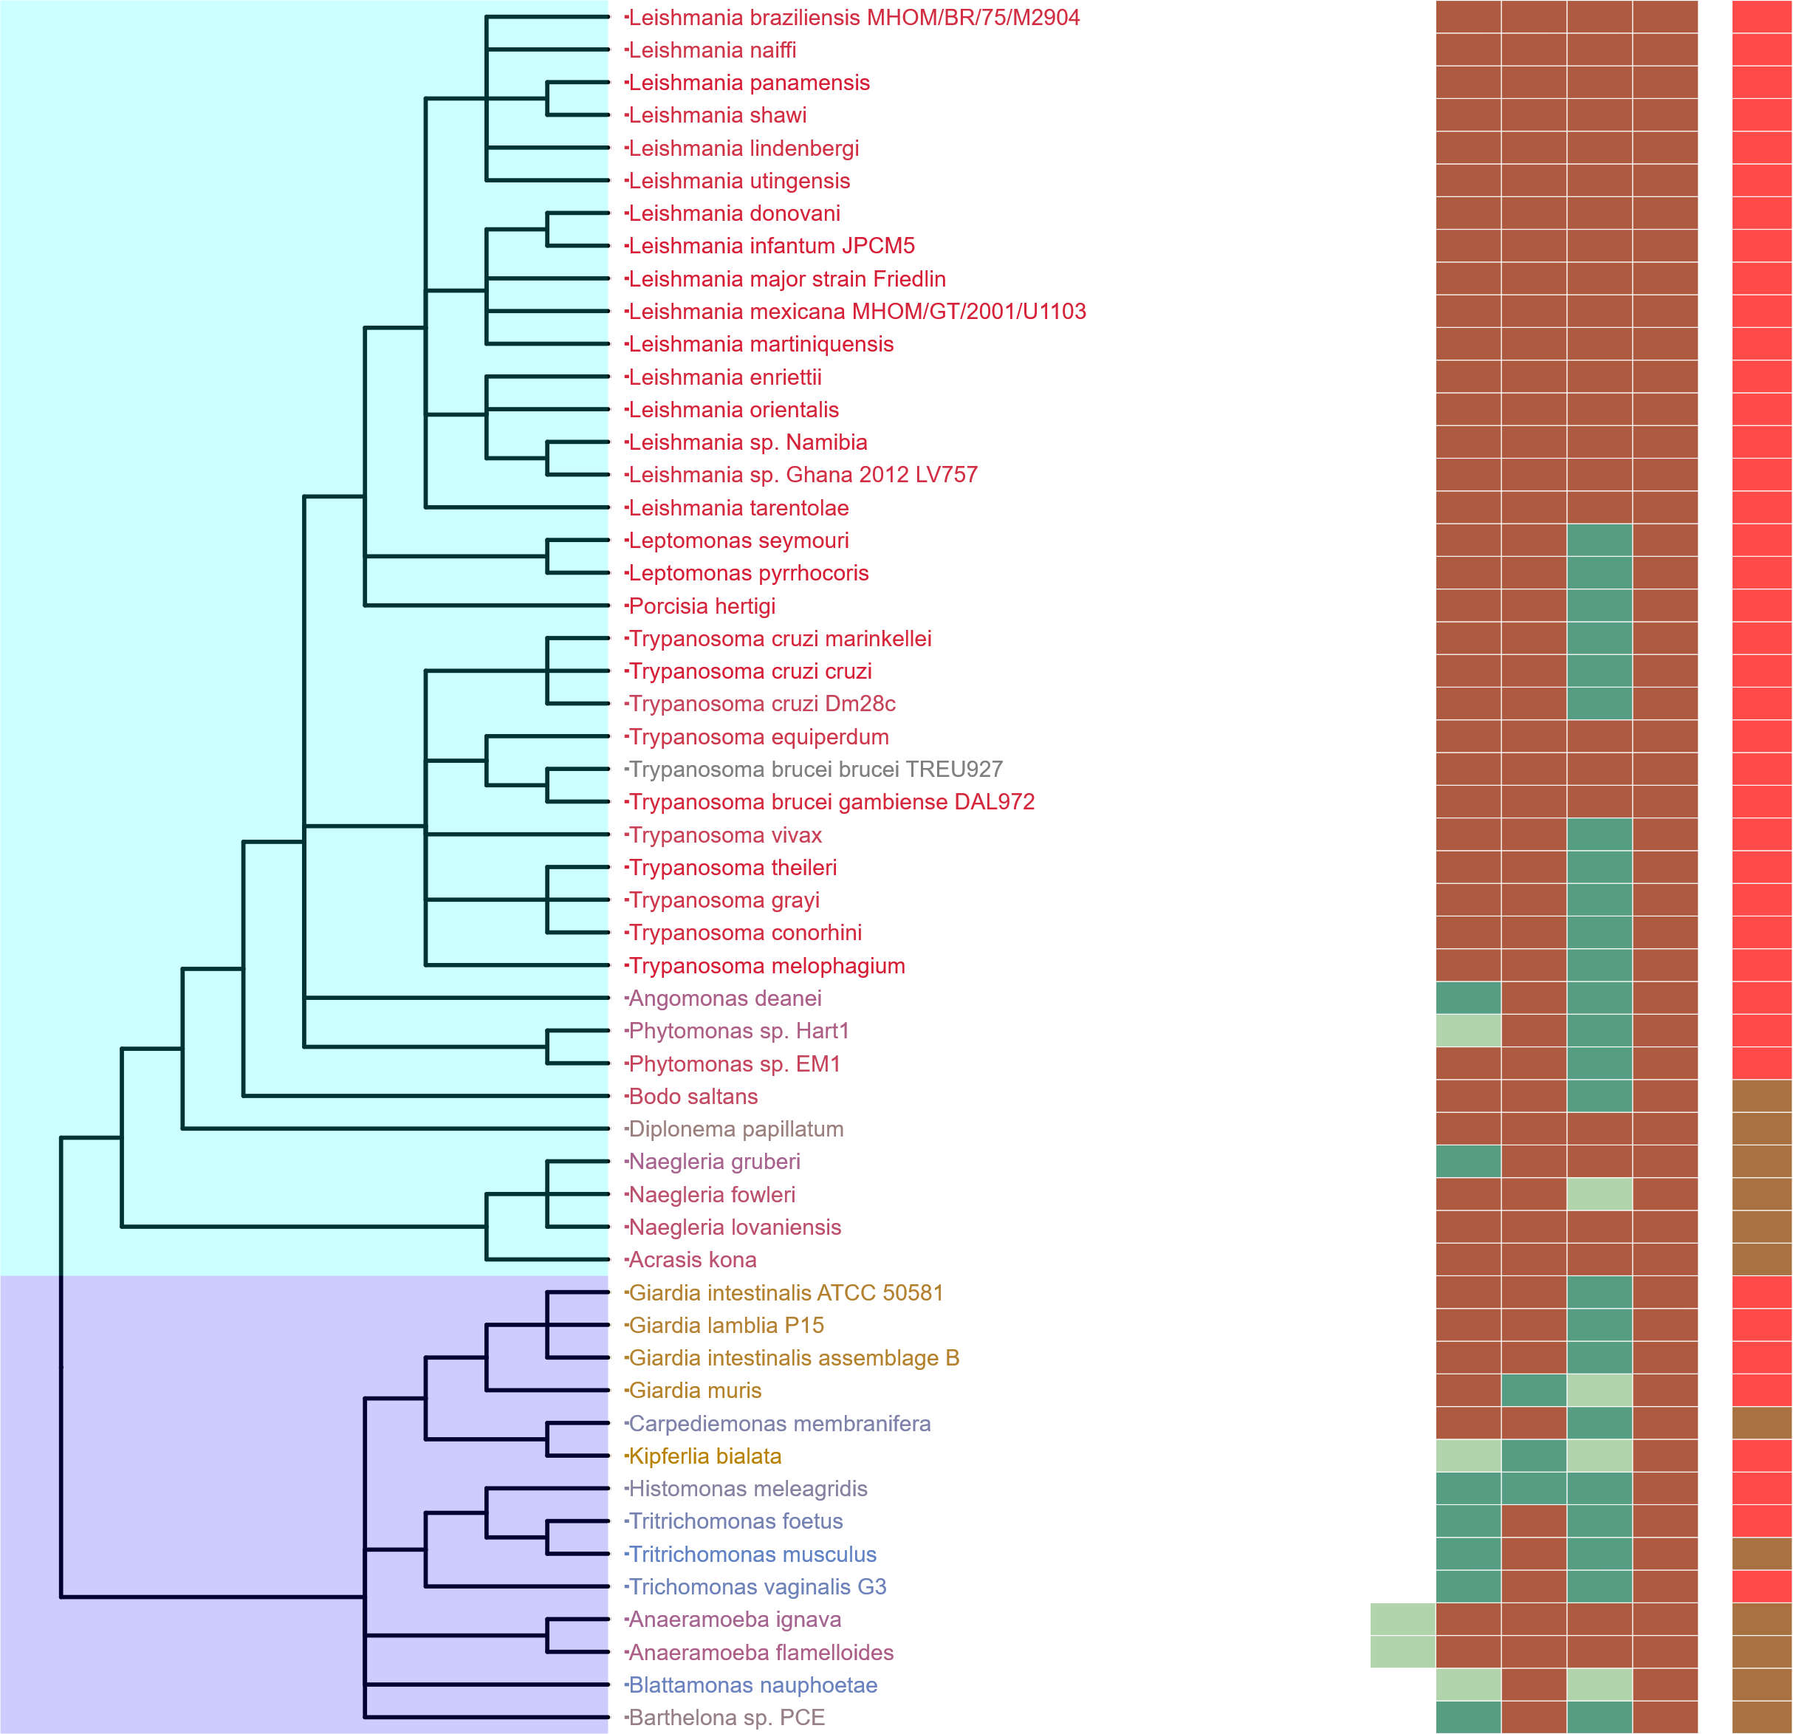
Supplemental 3
Completeness Score
100
75
50
25
Discoba
HMMER Score
H
M
L
P
ABS
Metabolic Strategy
Autotrophic
Heterotroph
Metamonada
Mixotroph
Plastid Parasite
Non-Plastid Parasite
Endosymbiotic
Notes:
Supplemental (3)

Slide 4
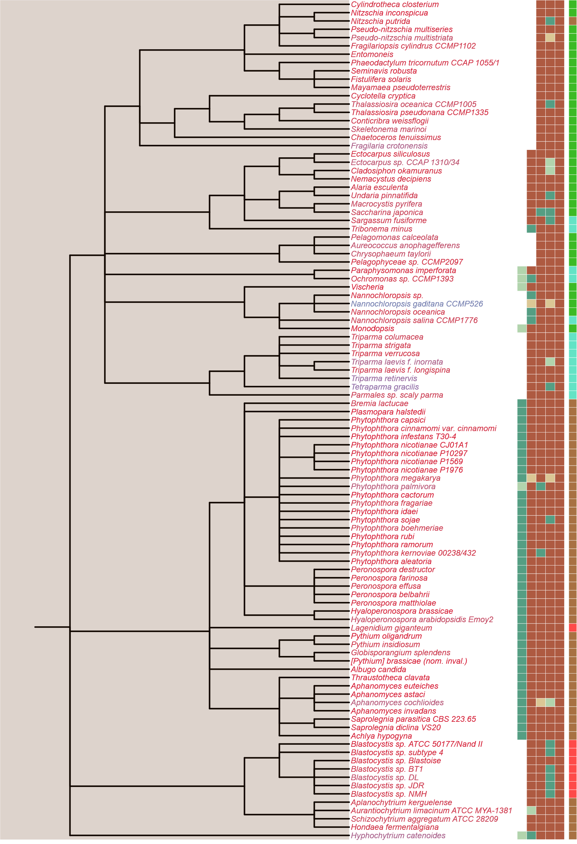
Supplemental 4
SIN1
RICTOR
RAPTOR
LST8
TOR
Completeness Score
100
75
50
25
HMMER Score
H
M
L
Stramenopiles
P
ABS
Metabolic Strategy
Autotrophic
Heterotroph
Mixotroph
Plastid Parasite
Non-Plastid Parasite
Endosymbiotic
Notes:
Supplemental Stramenopiles

Slide 5
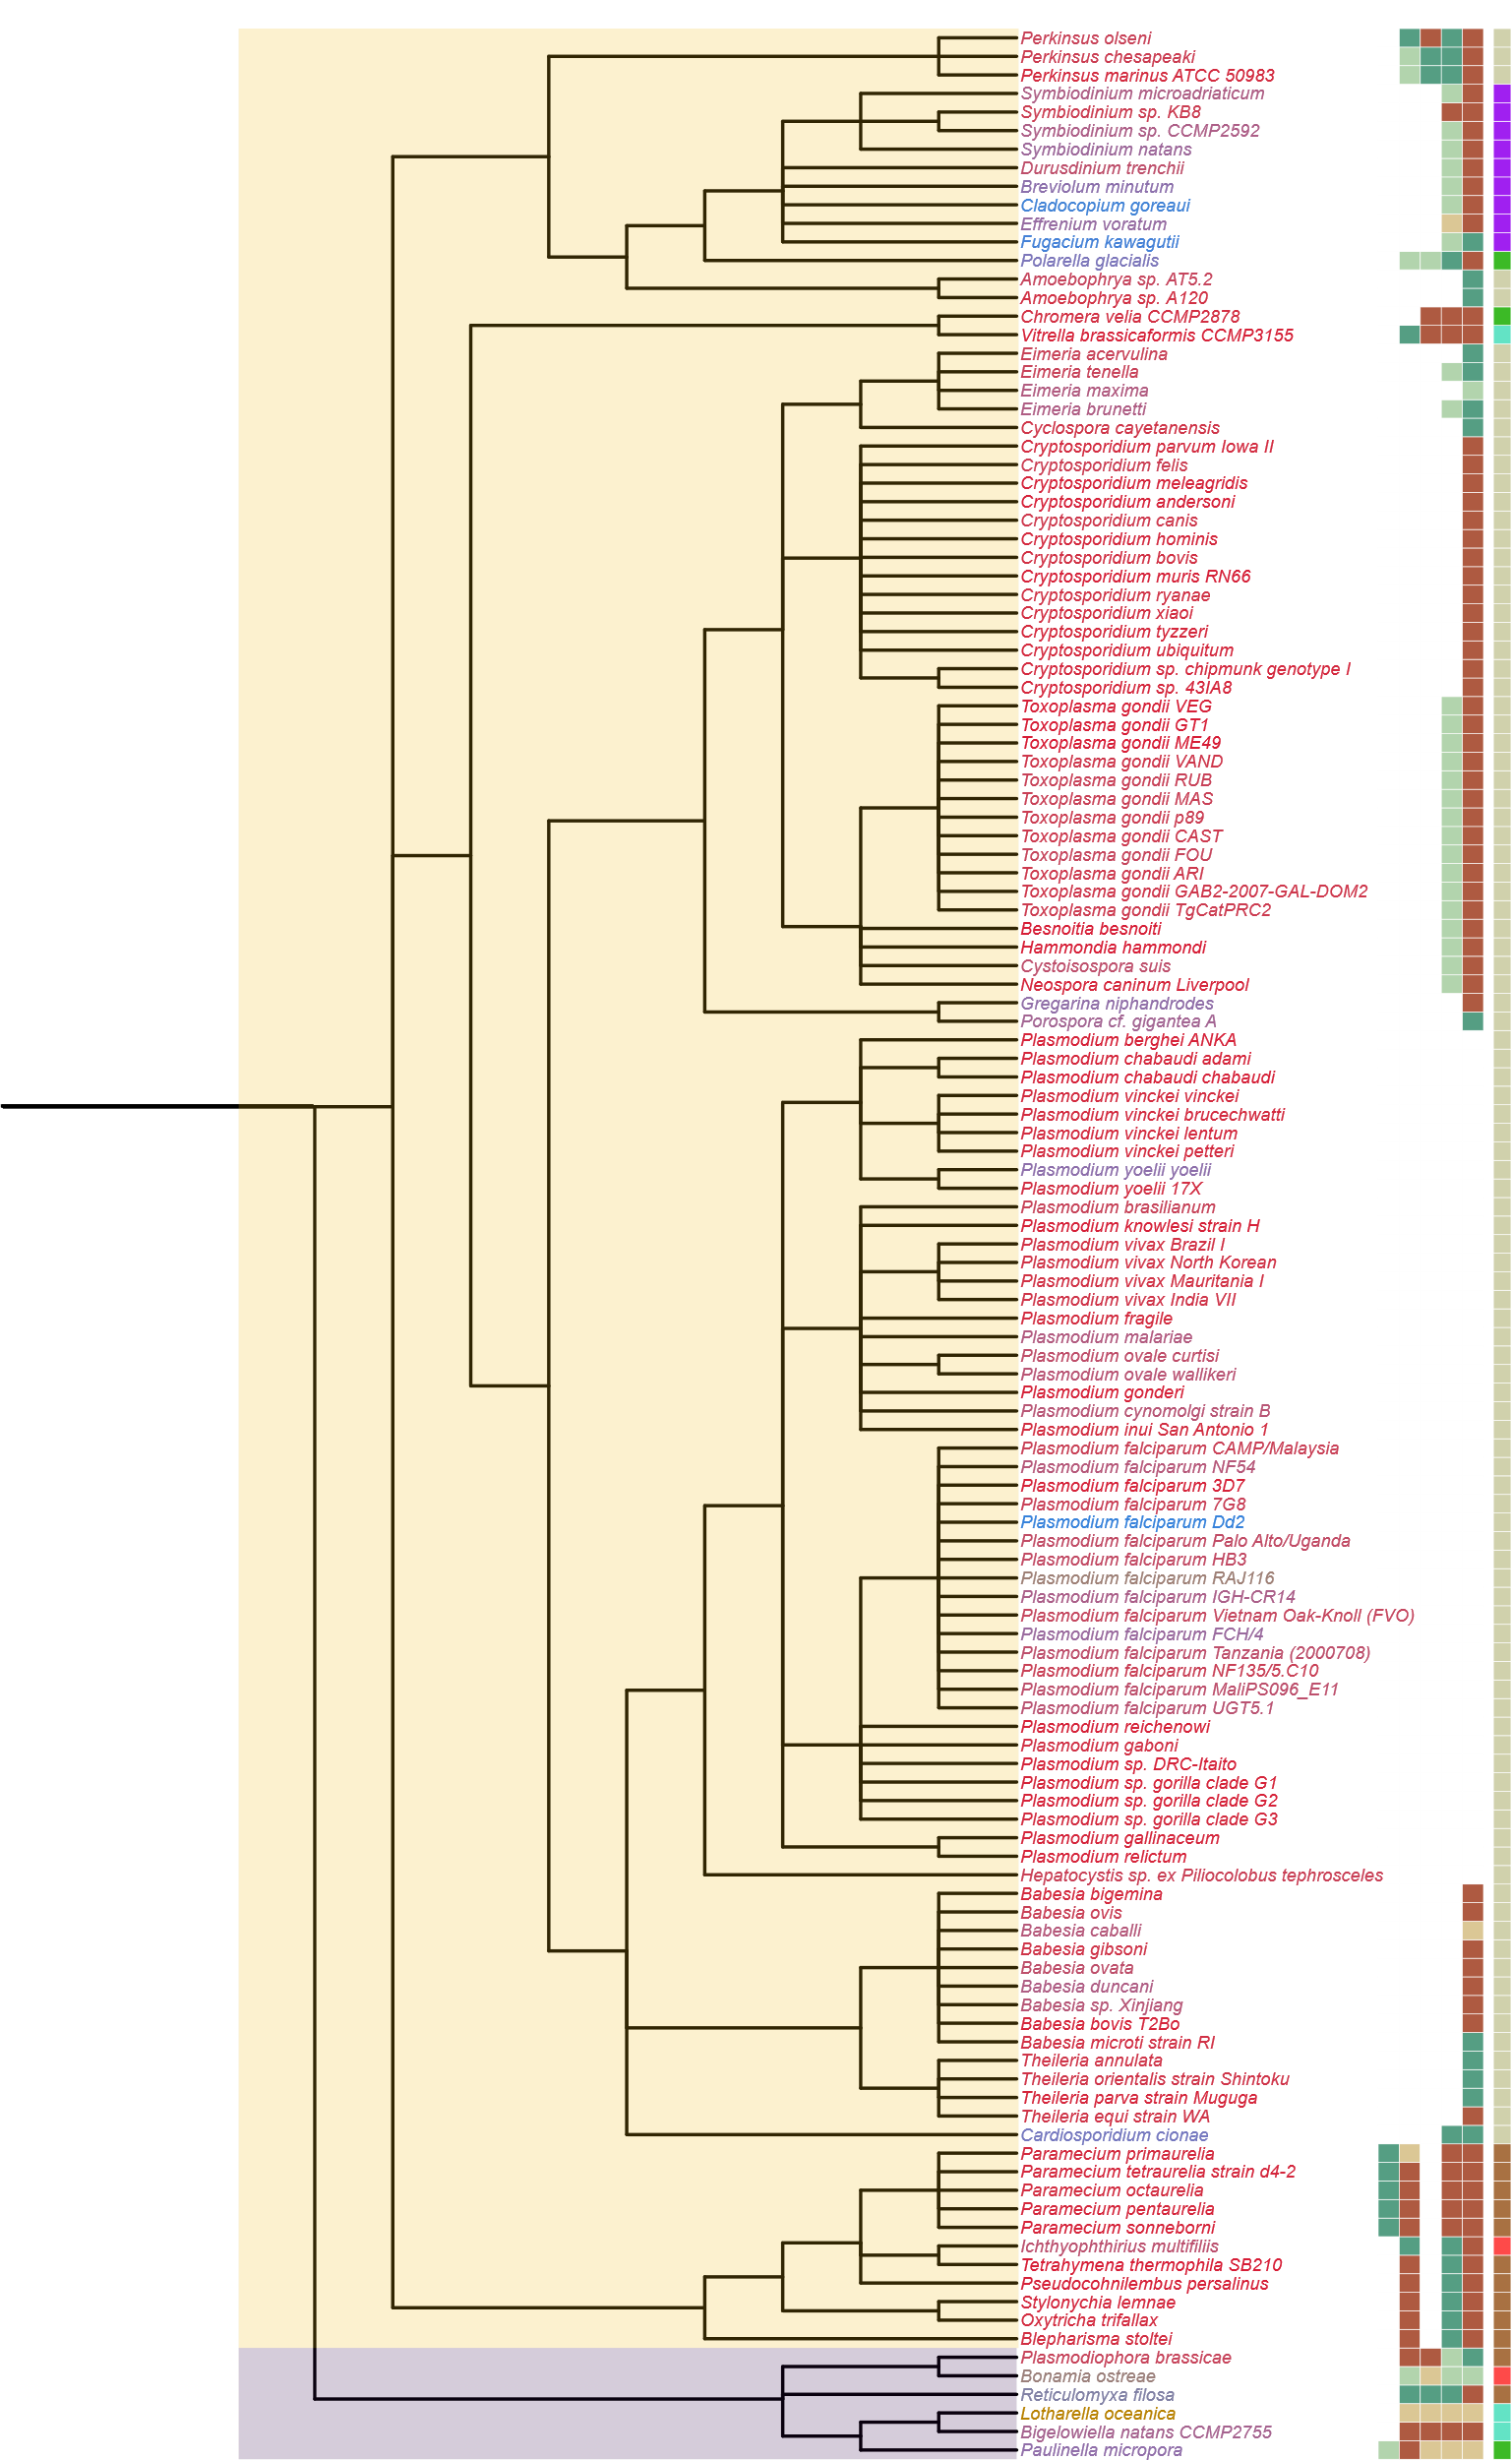
Supplemental 5
SIN1
RICTOR
RAPTOR
LST8
TOR
Completeness Score
100
Alveolata
75
50
25
HMMER Score
H
M
L
P
ABS
Metabolic Strategy
Autotrophic
Heterotroph
Mixotroph
Plastid Parasite
Non-Plastid Parasite
Endosymbiotic
Rhizaria
Notes:
Supplemental Alveolata/Rhizaria

Slide 6
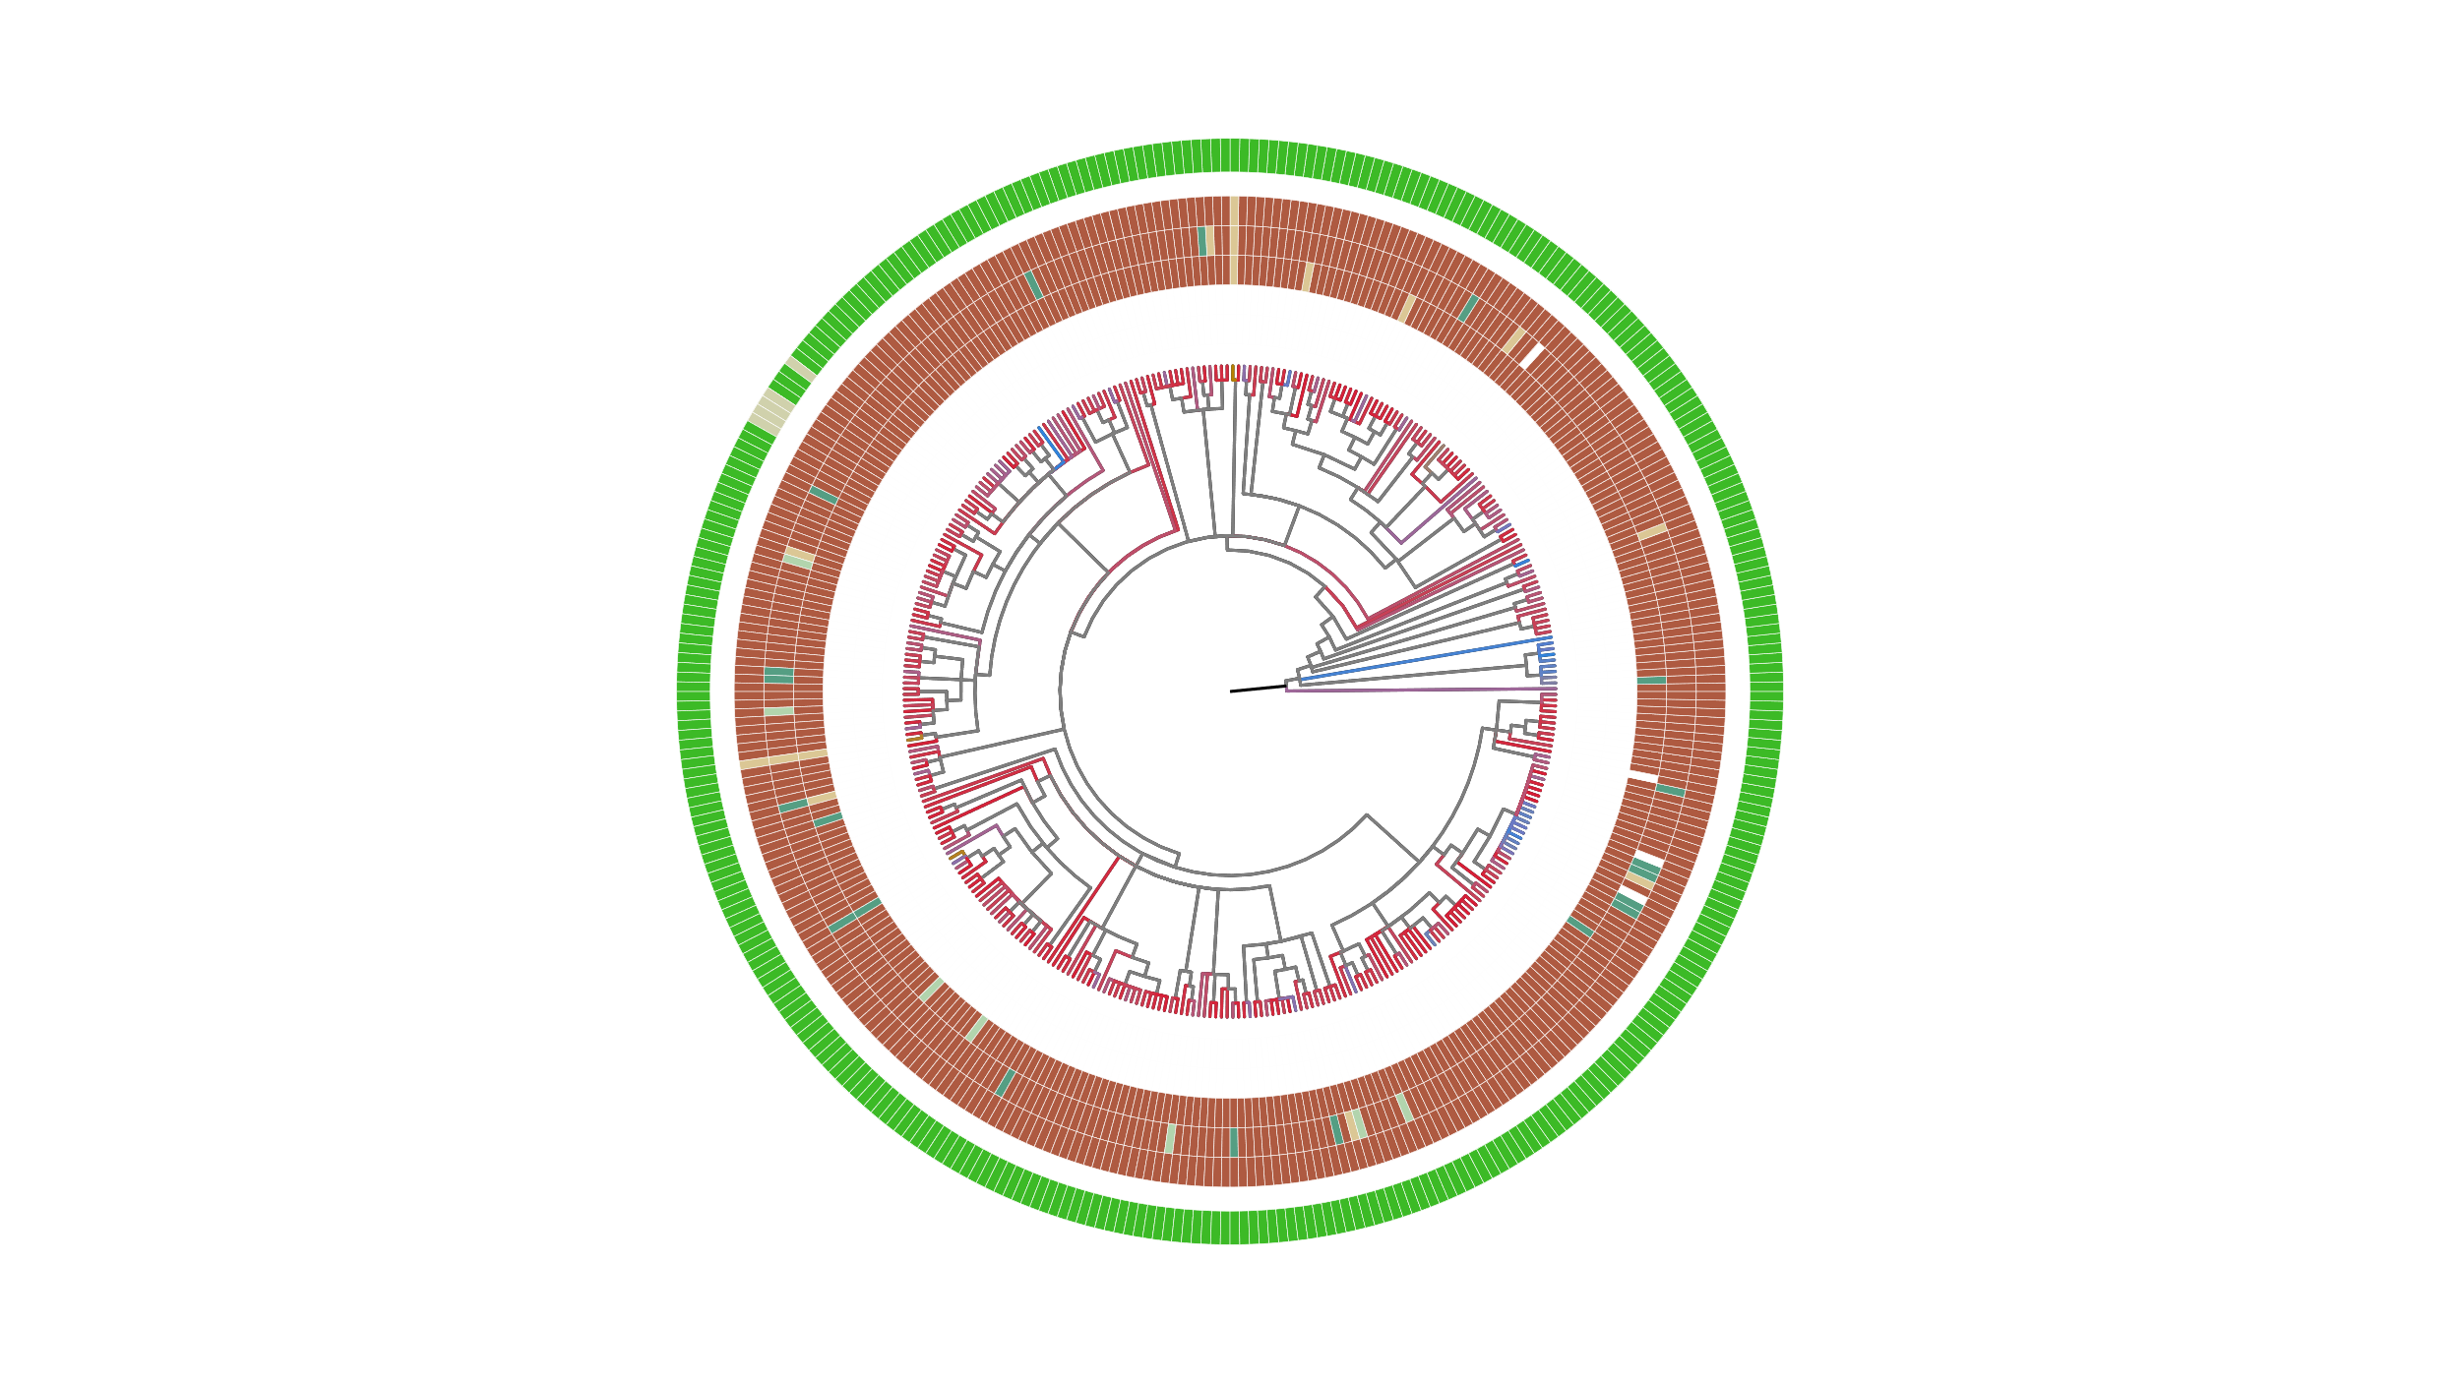
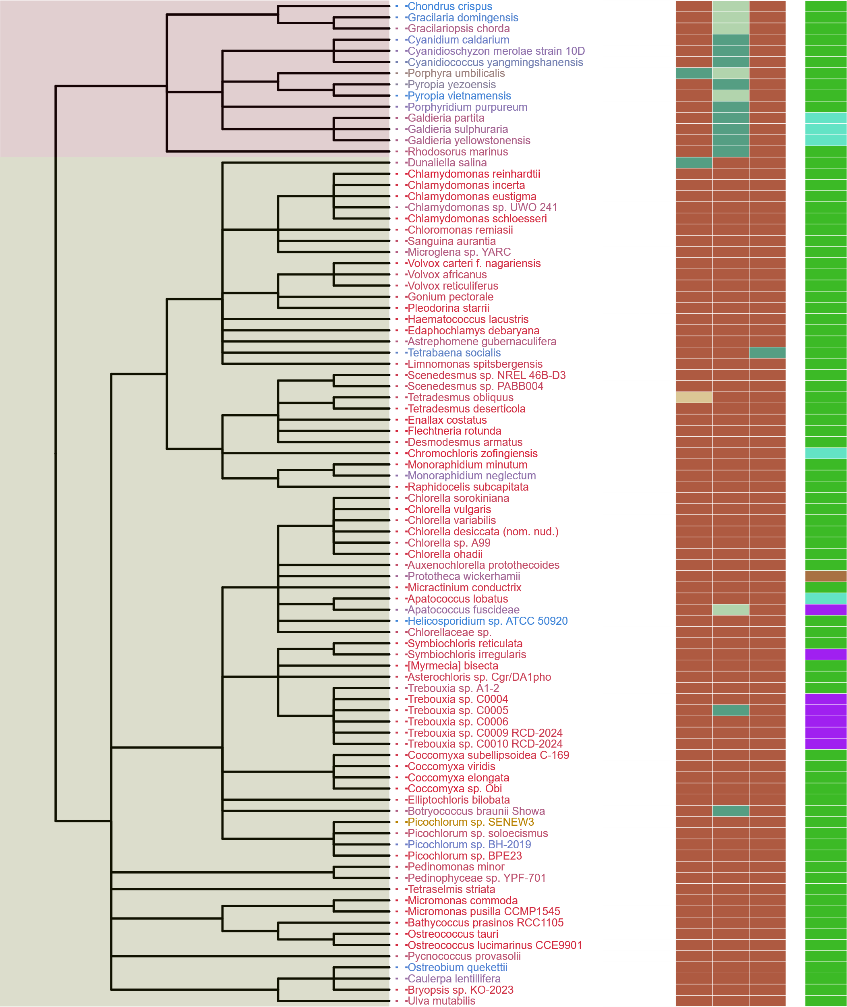
Supplemental 6
Completeness Score
SIN1
RICTOR
RAPTOR
LST8
TOR
100
75
Streptophyta
Rhodophyta
50
25
HMMER Score
H
M
L
P
Chlorophyta
ABS
Metabolic Strategy
Autotrophic
Heterotroph
Mixotroph
Plastid Parasite
RAPTOR
LST8
TOR
Non-Plastid Parasite
Endosymbiotic
Notes:
Supplemental Archaeplastida

Slide 7
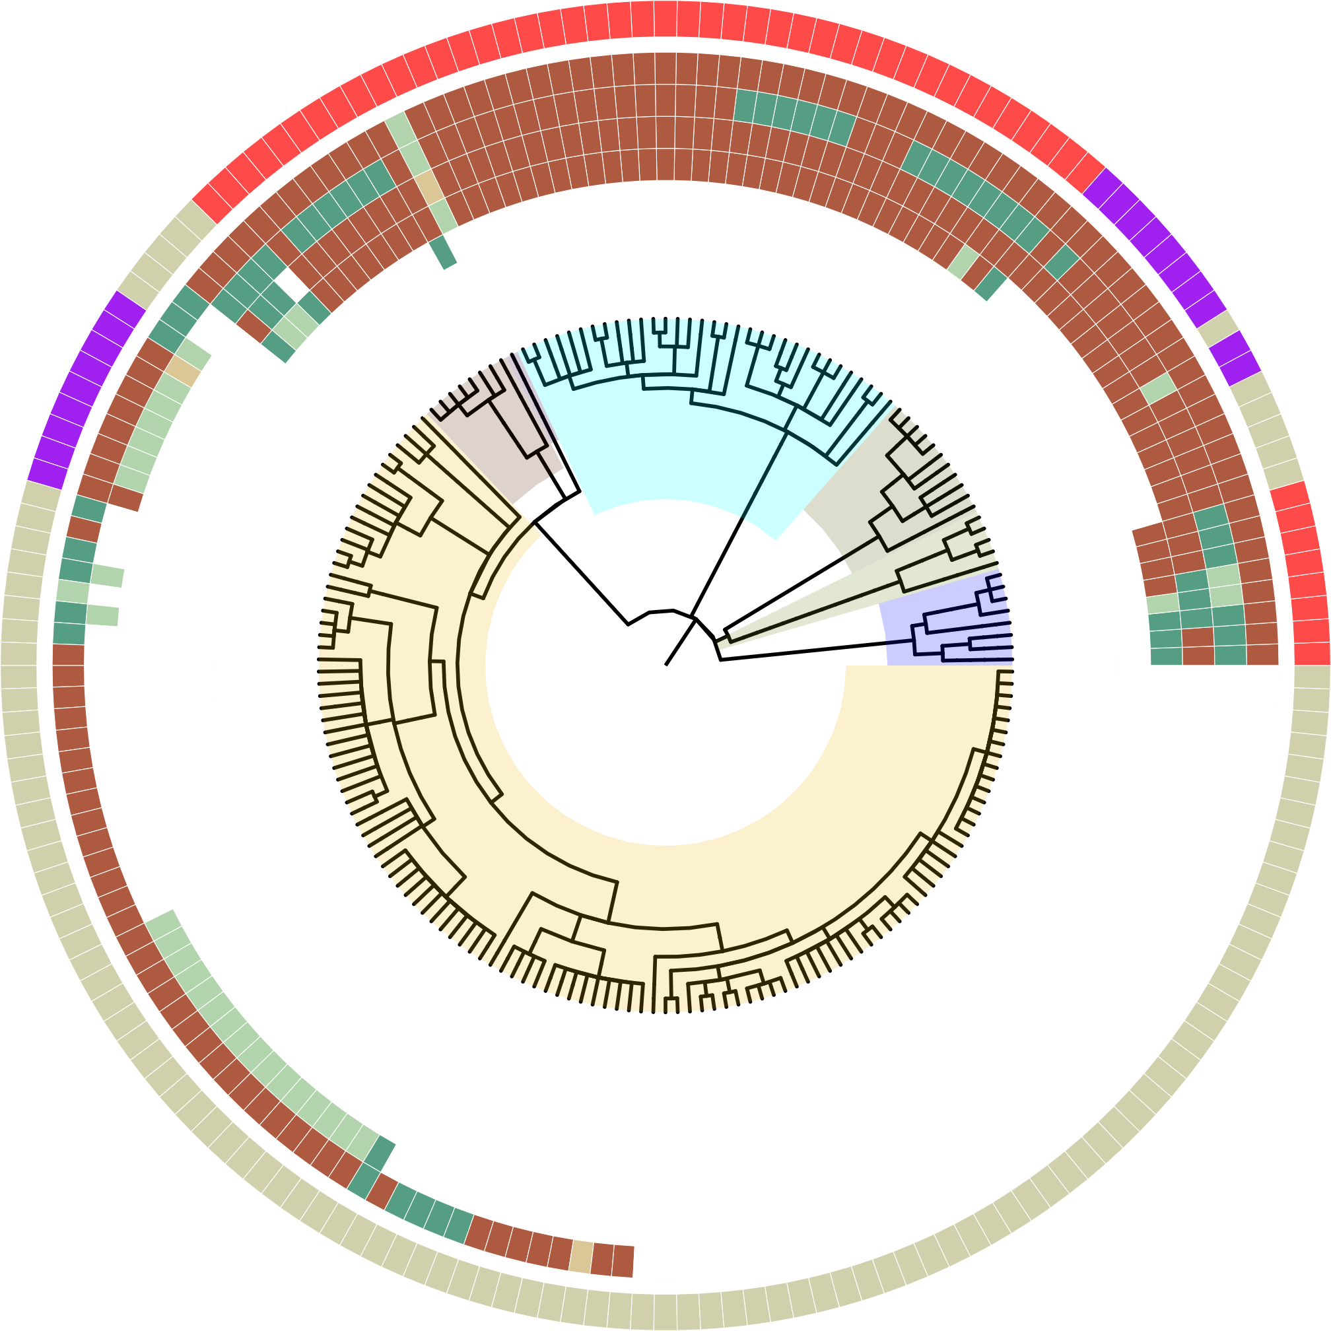
Supplemental 7
HMMER Score
H
M
L
P
ABS
Super Group
Alveolata
Stramenopiles
Rhizaria
Streptophyta
Chlorophyta
Discoba
Metamonada
Metabolic Strategy
Plastid Parasite
Non-Plastid Parasite
Endosymbiotic
Notes:
Early Prototype, just getting the style of the tree down first (Supplemental for Endosymbiotes/Parasites)

